Slide 1
Azure Logic Apps

Slide 2
What is Azure Logic Apps?
Azure Logic Apps is a cloud service that helps you schedule, automater, and orchestrate tasks, business processes and workflow when you need to integrate apps, data, systems, and services across enterprises or organization
Examples:
Send email notifications when events happens in various systems, apps and services.
Upload or modify a file in Azure Storage.
Monitor tweets for a specific subject, analyze the sentiment and create alerts or tasks for items that need review

Slide 3
Workflow : in an Azure Logic App is a sequence of actions or processes defined in steps. The actions will perform the business operations when input is provided through the managed connectors. Every workflow will be initiated by the trigger being fired. By defining the workflow in Azure Logic Apps, business processes can be automated and visualized in a hierarchy.
Connectors provide triggers and actions that you use to perform tasks in your logic app's workflow. Each trigger and action has properties that you can configure. Some triggers and actions require that you create and configure connections so that your workflow can access a specific service or system.
Actions are the steps those run once initiated by trigger. Whenever a Azure Logic App gets triggered, there will be a succession of actions those run to complete the workflow. Actions are processes those will perform the designated business task based on the data provided by the user. Users can select the required action from the extensive set of actions available in the connector repository.
Triggers are the starting point for a Azure Logic App workflow that will fire when new data or event that meets the trigger condition occur. Connectors in Logic App itself provide various triggers.

Slide 4
How to create a Logic App?
The first step to start with a Logic App is to create one. Following are the steps to create a Logic App:
To work with Azure Logic App, you need an Azure subscription. If you don't have an Azure subscription, sign up for a free Azure account before you begin
In the Azure Portal, click on create a resource and select Logic Apps from the makeplace
Click create proceed
Provide the basic credentials and click Review + Create
Finally, click on Go to resource to navigate to the Logic App created

Slide 5
How do you trigger a Logic App?
Create a blank Logic App in the Azure portal
Select or search the trigger from the list given in the Logic App Designer
Run a trigger in a saved Logic App by using the Run Trigger option in the overview section

Slide 6
How does Logic App work?
In a Logic App, each workflow always starts with a single trigger. A trigger fires when a condition is met, for example, when a specific event happens or when data meets specific criteria. Many triggers include scheduling capabilities that control how often your workflow runs. Following the trigger, one or more actions run operations that , for example, process, handle, or convert data that travels through the workflow, or that advance the workflow to the next step. Logic apps deploy and run in the cloud on Azure
You can visually create workflows using the Logic Apps designer in the Azure portal, Visual Studio Code, or Visual Studio. Each workflow also has an underlying definition that's described using JavaScript Object Notation (JSON). If you prefer, you can edit workflows by changing this JSON definition. For some creation and management tasks, Logic Apps provides Azure PowerShell and Azure CLI command support. For automated deployment, Logic Apps supports Azure Resource Manager templates.

Slide 7
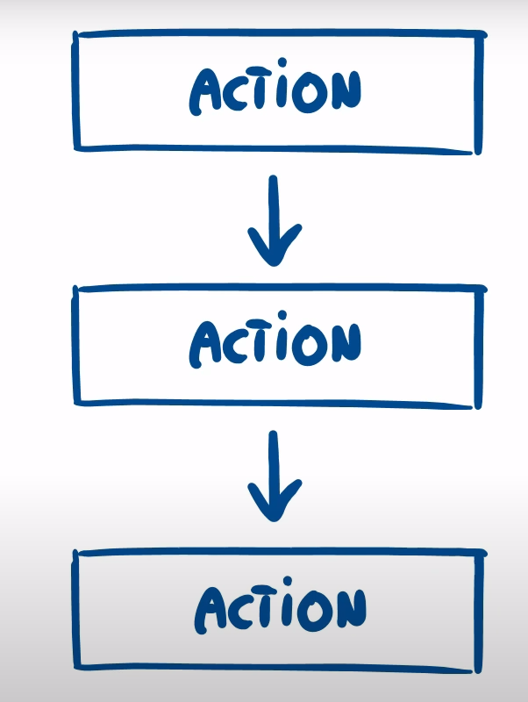
How does Logic App work?
Logic app is simple a sequence of actions that follow each other
Simple example:

Slide 8
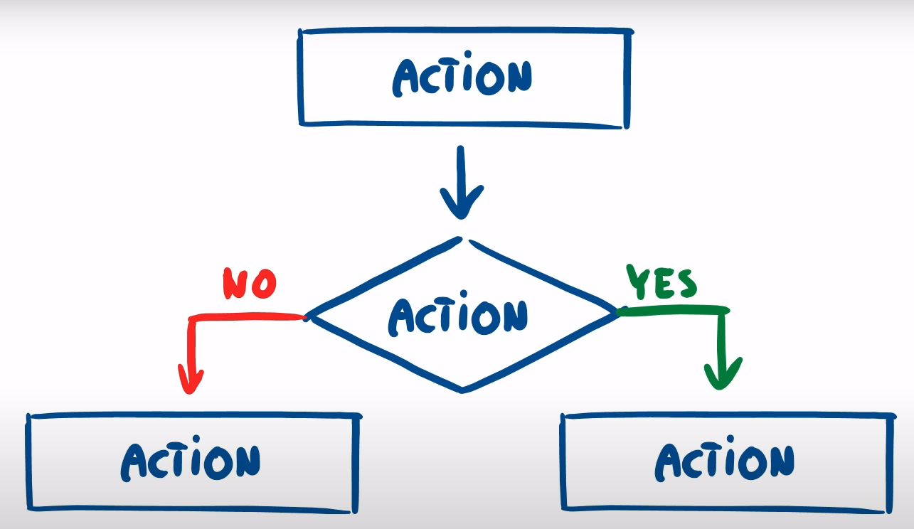
How does Logic App work?
More complex example : logic app has condition

Slide 9
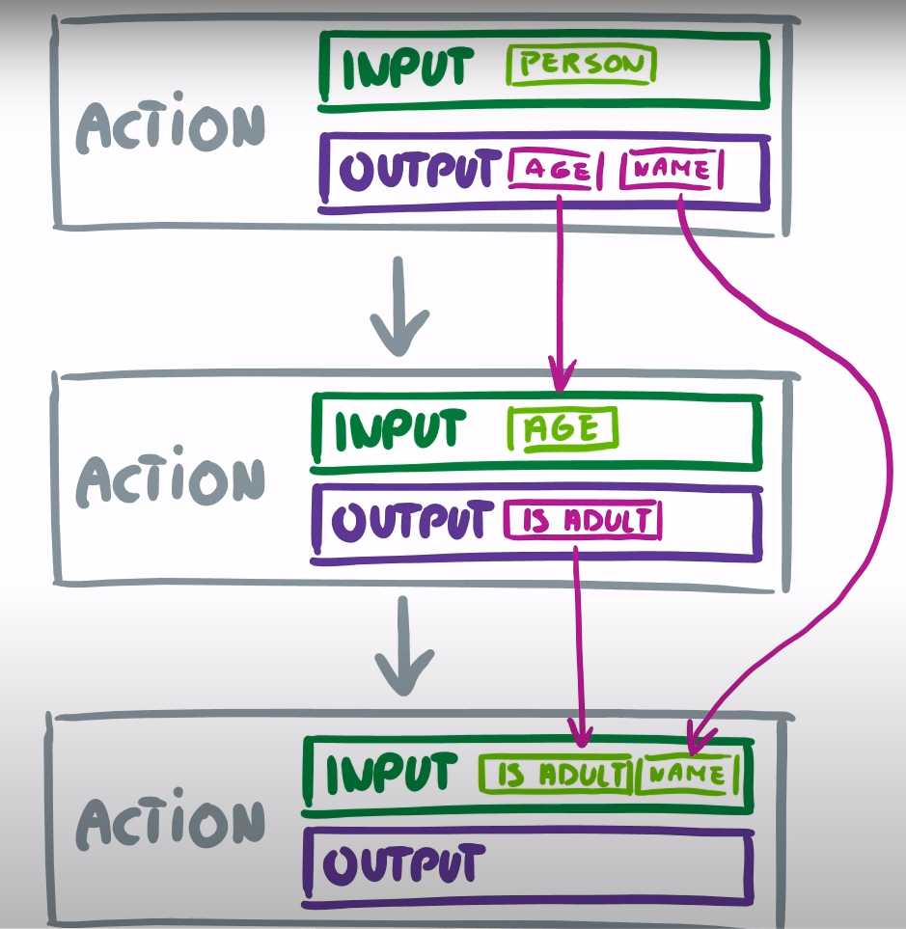
How does Logic App work?
Each action has input and output, output value of action contain in Dynamic content

Slide 10
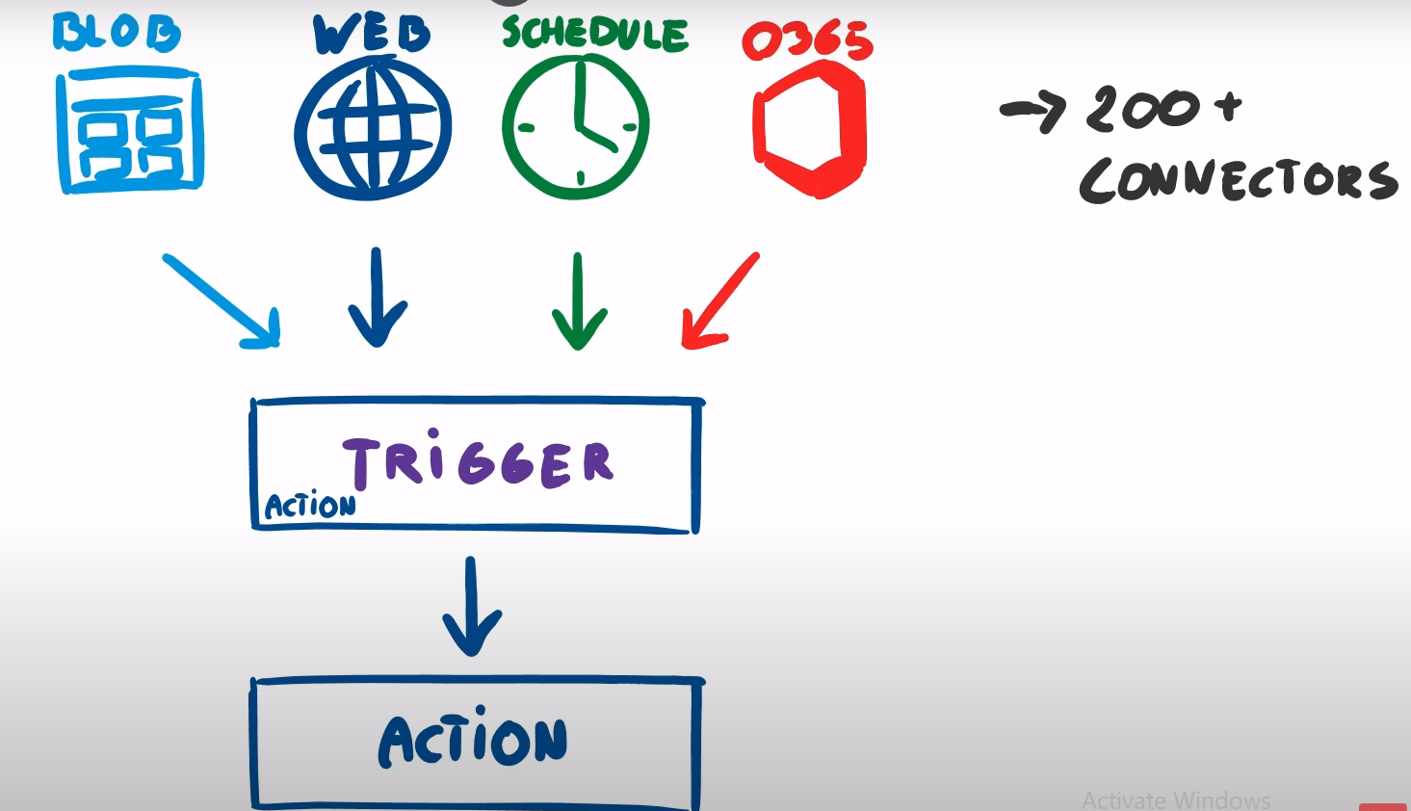
How does Logic App work?
The first action is always a trigger. This trigger can be called by multiple source maybe it’s a web request, maybe it’s a schedule based trigger or maybe it’s just a blob storage event...

Slide 11
Why use Logic Apps
Visually build work-flows with easy to use tools
Get started faster with logic apps templates
Connect disparate systems across different environments
Write once, reuse often
Access resource inside Azure Virtual networks
Pay only for what you use

Slide 12
Demo
Request
Schedule
Azure Blob change file

Slide 13
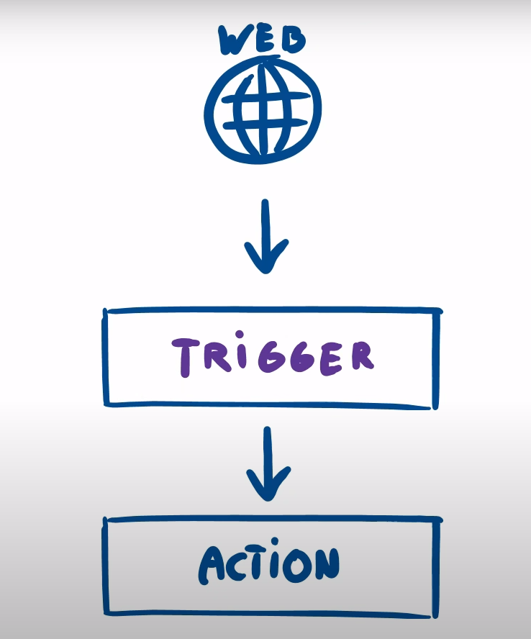
Web request demo

Slide 14
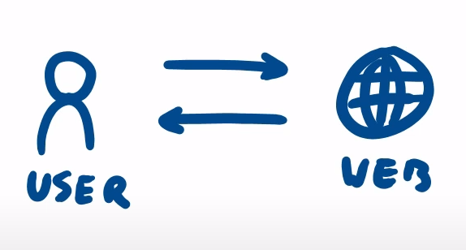
Web request Demo
Step 1:

Slide 15
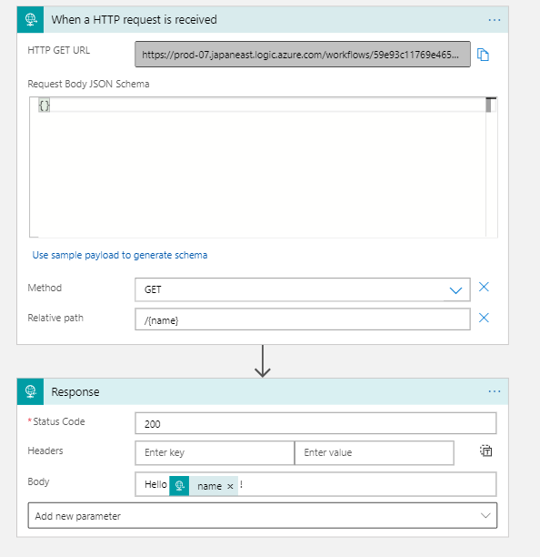
Web request Demo
Step 1:

Slide 16
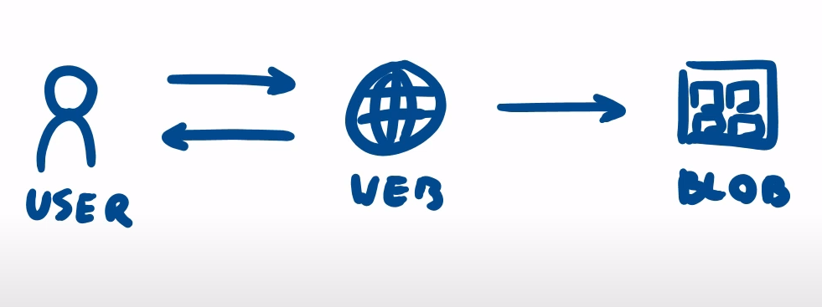
Web request Demo
Step 2:

Slide 17
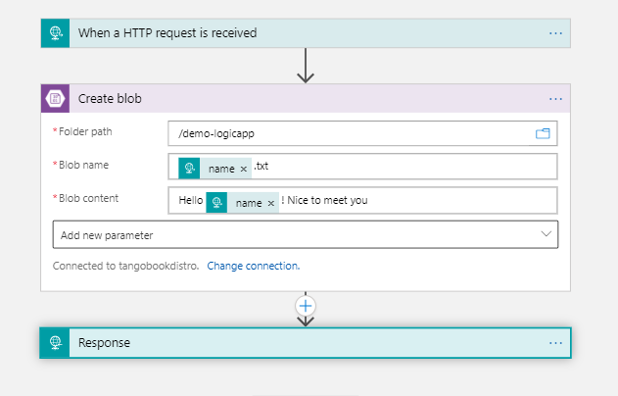
Web request Demo
Step 2:

Slide 18
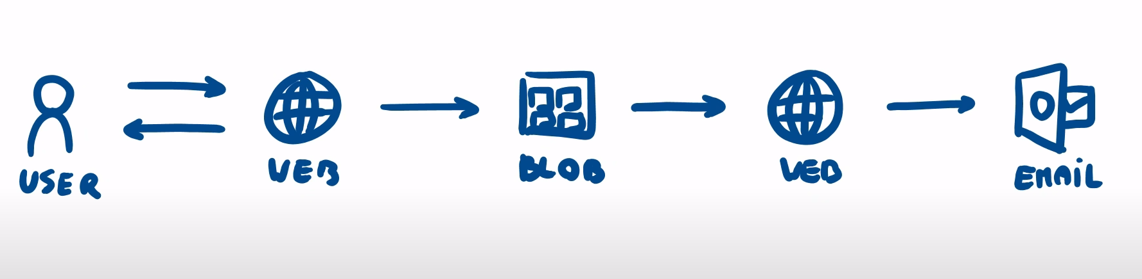
Web request Demo
Step 3:

Slide 19
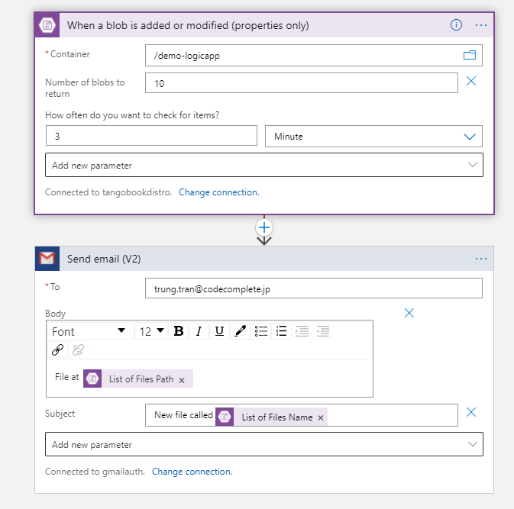
Web request Demo
Step 3: We create new logic app to listen blob event. When user send a request -> create blob -> blob event is triggered -> send email

Slide 20
How do I turn off Azure Logic App?
In the Azure portal, open your Logic App.
Under Logic App’s menu select Overview and click on Disable option from the toolbar.
To disable multiple Logic Apps, move into the Logic App section, bulk select and disable the Logic Apps.

Slide 21
How do I debug Logic App?
On the Logic App overview section, click on see trigger history to check if any triggers have failed.
Next, check for failed runs in the run history listed in the overview section.
Click on the failed run and perform runtime debugging.

Slide 22
Ways of controlling the flow
Parallel execution
Conditional execution
Conditions
Switches
Loops (Interations)
For-each
Until
Terminate
Scope

Slide 23
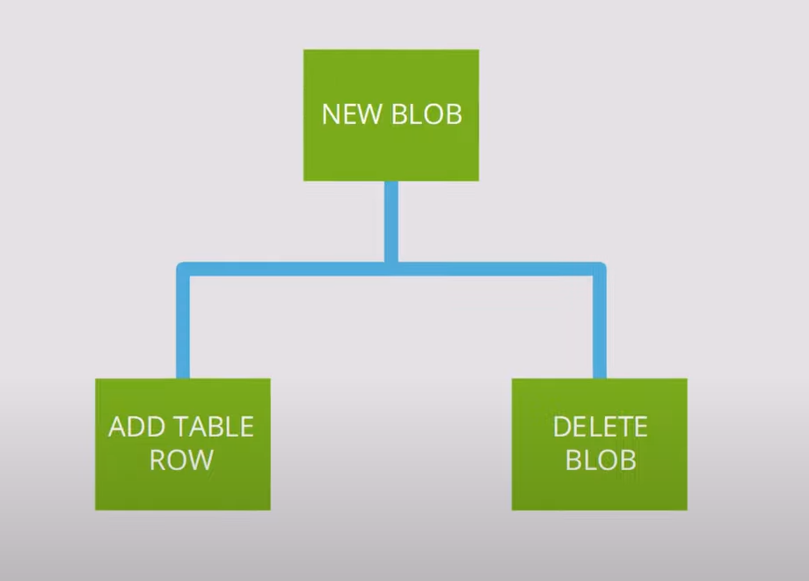
Ways of controlling the flow
Parallel Execution:
Split execution of your workflow into completely separate branches, each executed in parallel

Slide 24
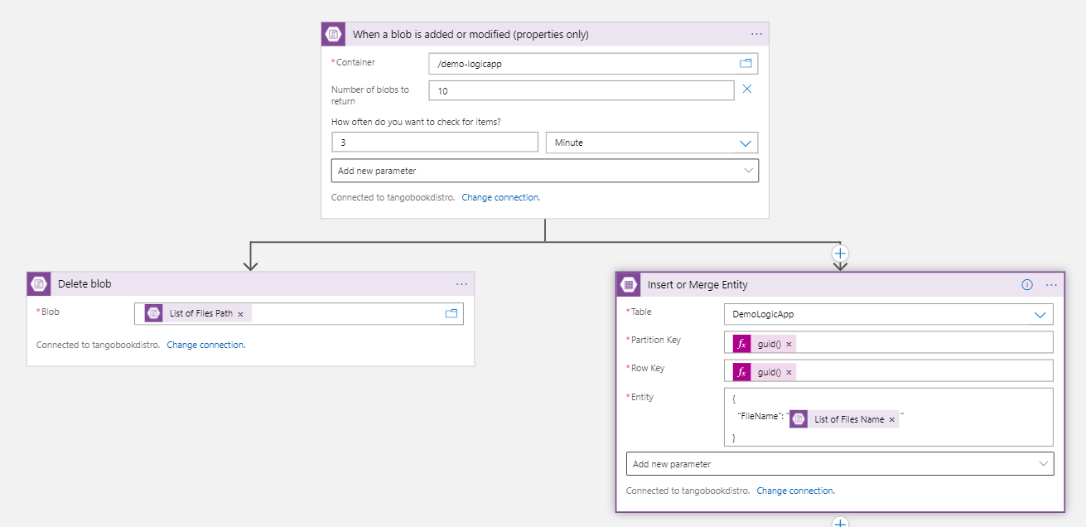
Parallel Execution Demo

Slide 25
Ways of controlling the flow
2. Condition excution
2.1 Conditions also split execution of your workflow into separate branches but only choose one of them depending on evaluation of specific condition.

Slide 26
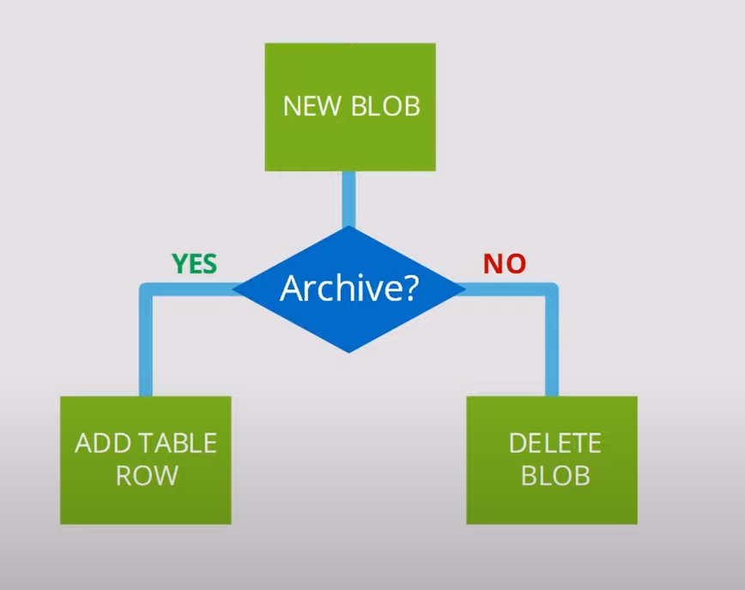
Conditional execution demo

Slide 27
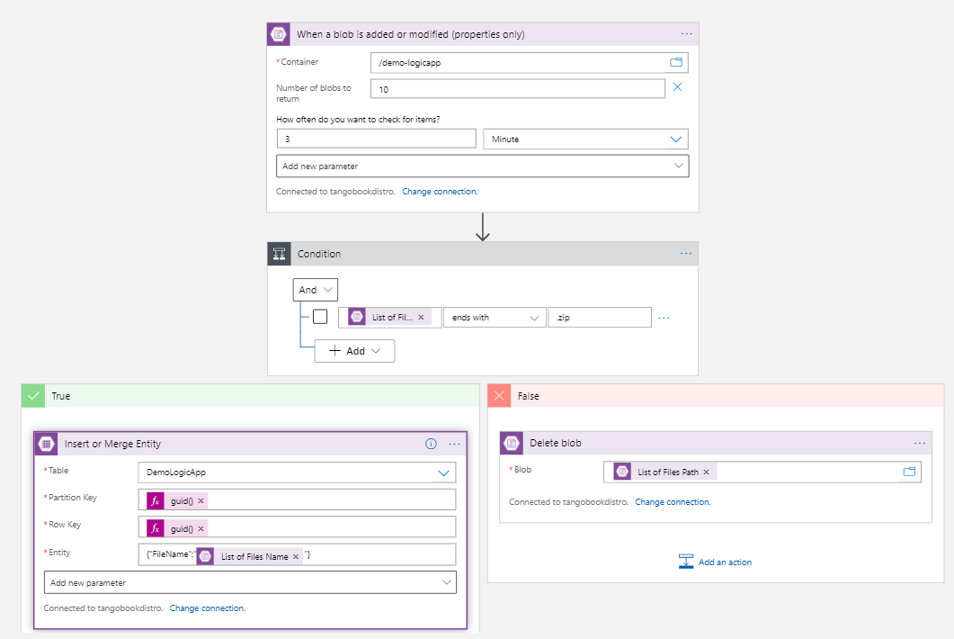
Conditional execution demo

Slide 28
Ways of controlling the flow
2. Condition execution
2.1 Switch control action can create multiple branches and choose one of them depending on condition.
2.2 Example: add new blob -> check blob MediaType :
* If it is image/png -> send email
* If it’s zip file (application/x-zip-compressed) -> save to Azure storage table

Slide 29
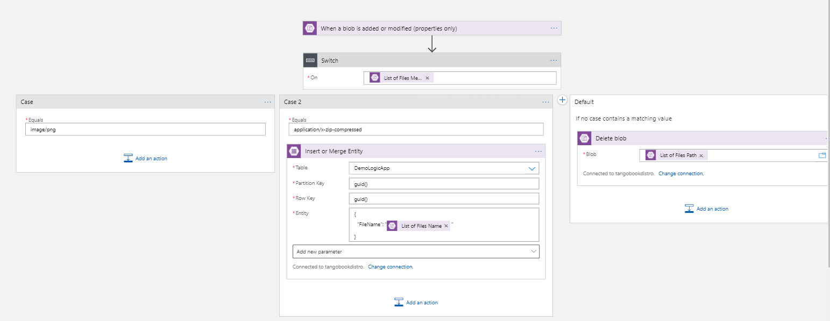
Conditional execution demo : Switch control

Slide 30
Ways of controlling the flow
3. Loops (Iterations)
When executing series of repeating actions you can use
3.1 For-each action which executes action for each item in a collection
3.2 Until action which runs until condition is met fr scenarios when you can’t determine amount of loops (same do-while statement)

Slide 31
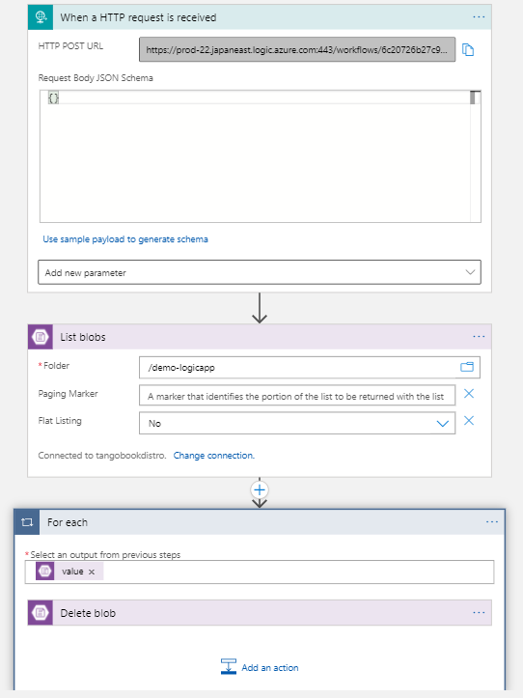
Foreach control demo

Slide 32
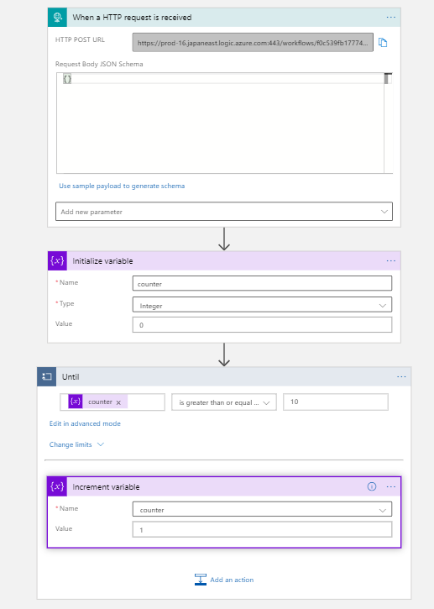
Until control demo

Slide 33
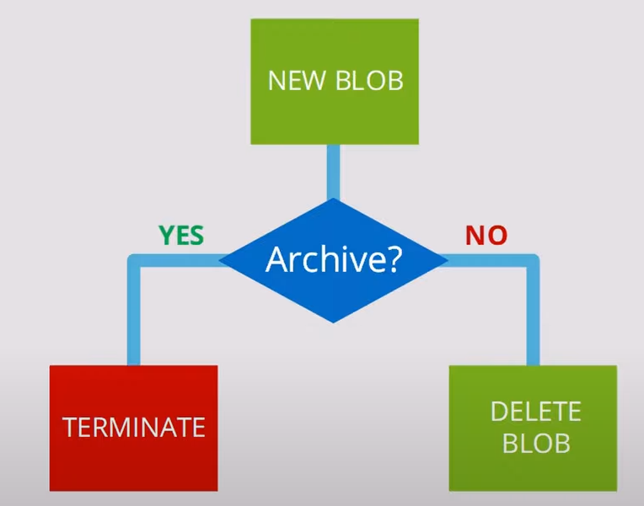
Ways of controlling the flow
4. Terminate
Terminate ends execution of the logic app on demand. Think of it like return statement in programming languages.
Example:

Slide 34
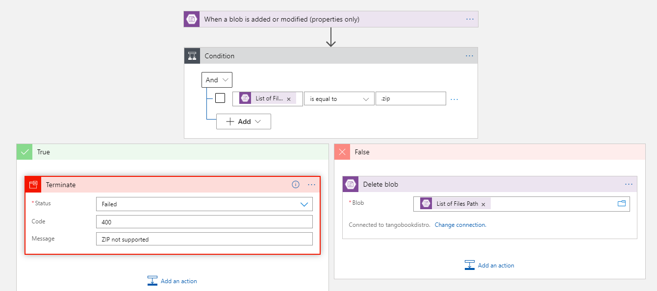
Terminate demo

Slide 35
Ways of controlling the flow
5. Scope
Scope encapsulates execution of set of workflow actions into single block. This is your way of error handling in Logic Apps, think of it like try catch block

Slide 36
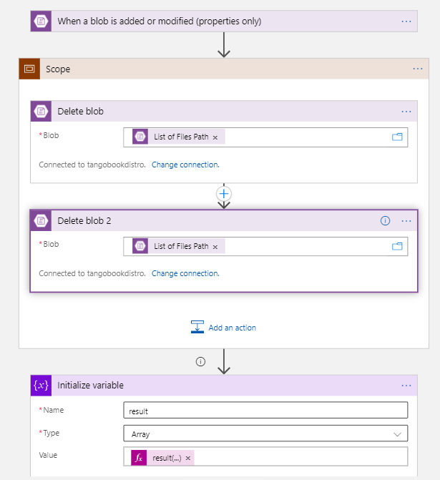
Scope demo

Slide 37
Related information
What is resource group ?
A resource group is a container that holds related resources for an Azure solution. The resource group can include all the resources for the solution, or only those resources that you want to manage as a group.

Slide 38
Related information
What is Azure Storage (Blob, Table...) ?
The Azure Storage platform is Microsoft's cloud storage solution for modern data storage scenarios. It includes the following data services:
Azure Blobs: A massively scalable object store for text and binary data. Also includes support for big data analytics through Data Lake Storage Gen2.
Azure Files: Managed file shares for cloud or on-premises deployments.
Azure Queues: A messaging store for reliable messaging between application components.
Azure Tables: A NoSQL store for schemaless storage of structured data.
Azure Disks: Block-level storage volumes for Azure VMs.

Slide 39
Related information
What is Dynamic content in logic apps ?
Dynamic content in logic app is the place to store output data of actions

Slide 40
Related information
What is logic app expression ?
An expression is a sequence that contains one or more functions, operators, variables, explicit values, or constants. In a workflow definition, expression can be used anywhere in a JSON string value by prefixing the expression with the at-sign ‘@’. When evaluating an expression that represents a JSON value, the expression body is extracted by removing the ‘@’ character. It always results in another JSON value.
Access here to detail

